Slide 1
Multi-Region AWS Aurora
A comparison of AWS Aurora & Continuent Tungsten for building a geo-scale, multi-region MySQL cloud back-end
By Matthew Lang, Director of Professional Services
May 30, 2019
Notes:
AWS Aurora is Great – It Could Be Better!
Join us to compare how to build geo-scale, multi-region MySQL Cloud backend using AWS Aurora and Continuent Tungsten

Slide 2
Welcome!
“Continuent, the MySQL Availability Company”

Slide 3
Who are you anyway?
Most people call me Matt
Started as Programmer/DBA for Progress 4GL database
Wrote real time replicator from/to MySQL and Progress Database called Pro2MySQL
Part time Musician
Just learned how to do Animations in PowerPoint ☺

Slide 4
What else?
Prior to Continuent, was Senior Site Reliability Engineer for rapidly growing Health Care Company.
Responsible for approx. 100 MySQL databases
Demanded many, many 9’s…..
Automation and consistency was key

Slide 5
Goals
We will explore how to deploy Geo-Scale MySQL* with the following design criteria:
Local rapid-failover, automated high availability
Geographically distributed, low-latency data with a single consolidated view
Fast local response times for read traffic
Ability to deploy MySQL masters in multiple regions
No changes to application code
Complex schema changes while keeping applications available
Avoid provider lock-in
* MySQL is understood in a broad context, including MySQL, MariaDB, Percona Server, RDS MySQL, RDS Aurora and Google Cloud SQL

Slide 6
Aurora Multi-Region
Notes:
1.5 min

Slide 7
Aurora Key Benefits
Not MySQL, but MySQL 5.6/5.7-compatible
Read Replicas
Distributed file system. Data Replicated 6 ways across three AZ’s.
Cross-Region Replication within AWS
Promote remote read replica to standalone DB cluster
Fast, in specific scenarios

Slide 8
Aurora Cross Region Replica Requirements
Source Aurora cluster
Enable binary logging on the on the source Aurora cluster (quite a few settings to change)
A VPC in the target cluster
Database Subnet within the VPC (be sure you’re familiar with VPC’s and subnets, a lot of issues are caused here)
Subnet should be public-accessible if machines outside of the network will access the Aurora instance!

Slide 9
Create Aurora Cross Region Replica
Select source cluster, then “Actions” -> “Create cross region read replica”
Select destination region, DB subnet, Instance size, and monitoring options
Click create
Creation time is at least 20 minutes for small DB.

Slide 10
How much does it cost?
3 node primary cluster (1 writer, 2 readers)
1 cross region replica
db.r4.8xlarge
$15,262/month or $183,144/year

Slide 11
Limitations using Aurora
Master is single region only
Failover disconnects application (CNAME change)
Long failover times ( > 30 seconds)
Innodb engine only
Application must be read/write aware – no connectivity layer
All data stays in AWS
Database maintenance and schema changes can cause application outages
Proprietary, not open source

Slide 12
How much HA do you need?
Do you want your doctor to see this for 30-90 seconds during your visit?
Is he helping you during this time?
How does this affect your trust in his diagnosis and treatment?
Can doctors help patients when their systems are down?

Slide 13
Real World Issues
Cross region replication breaks
Not possible to repair
Support advises customer to recreate and reload their remote replicas
Not Sustainable
On your own?

Slide 14
How Do We Make It Better?

Slide 15
Review: Webinar Goals
We will explore how to deploy Geo-Scale MySQL* with the following design criteria:
Local rapid-failover, automated high availability
Geographically distributed, low-latency data with a single consolidated view
Fast local response times for read traffic
Ability to deploy MySQL masters in multiple regions
No changes to application code
Complex schema changes while keeping applications available
Avoid provider lock in
* MySQL is understood in a broad context, including MySQL, MariaDB, Percona Server, RDS MySQL, RDS Aurora and Google Cloud SQL

Slide 16
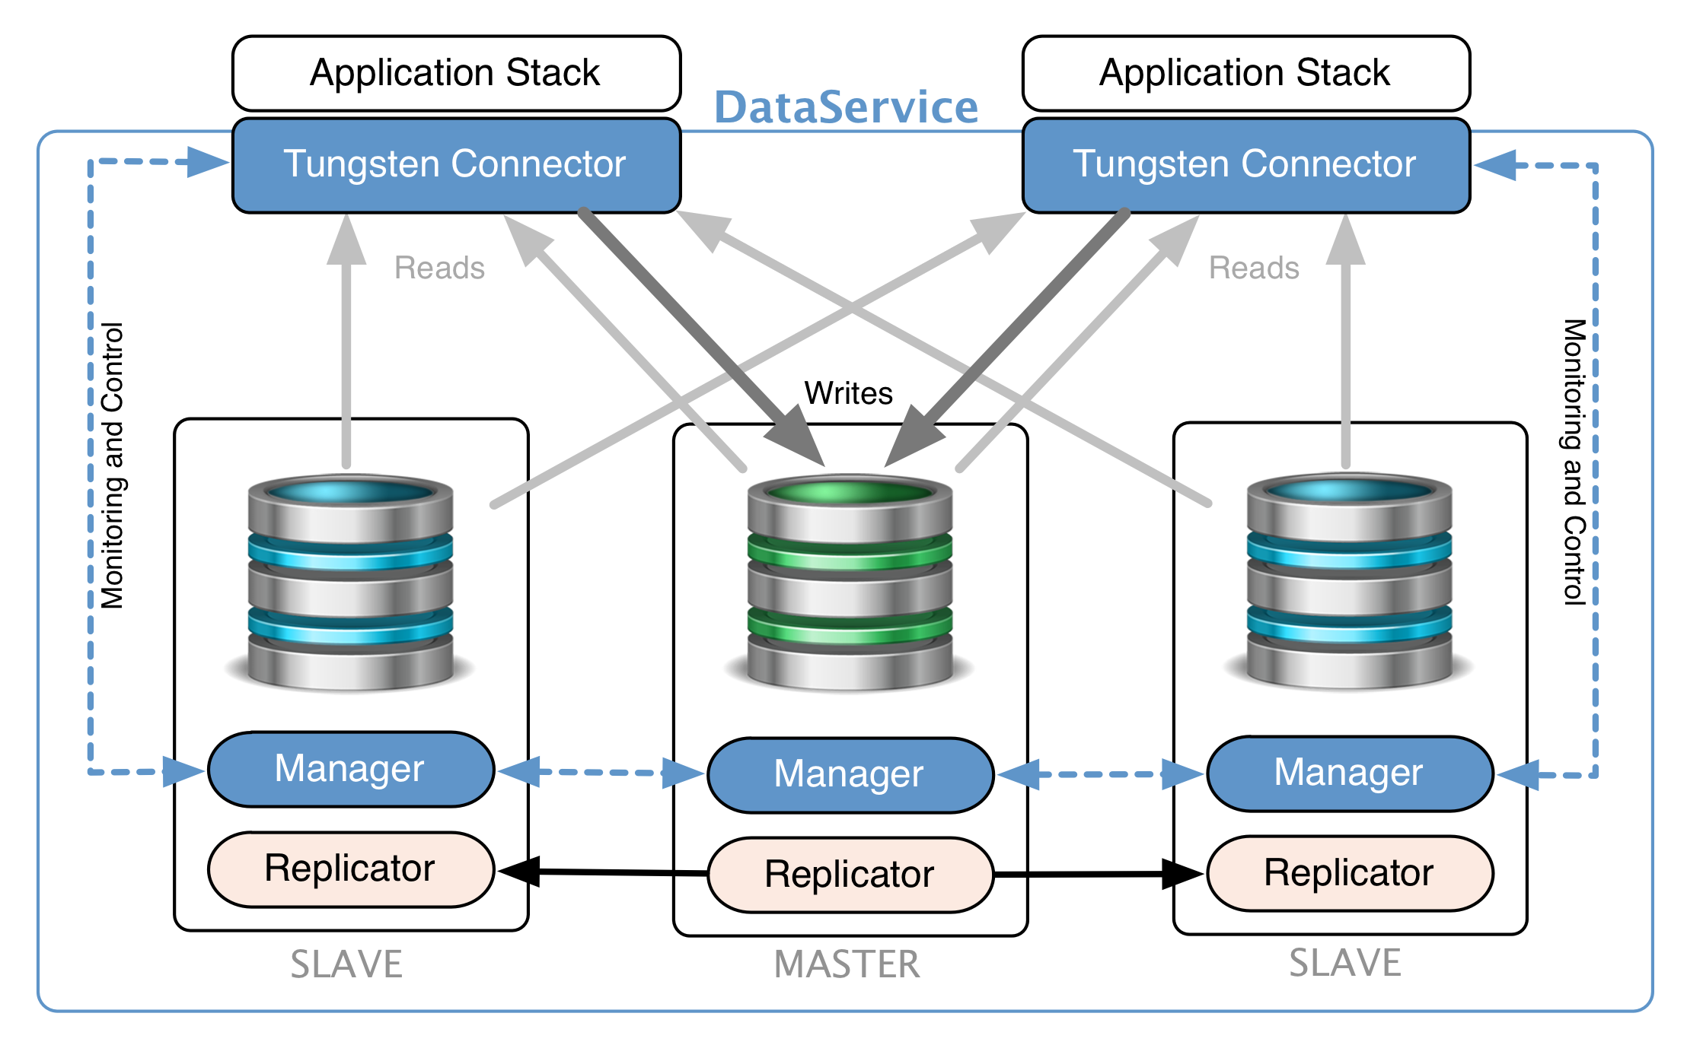
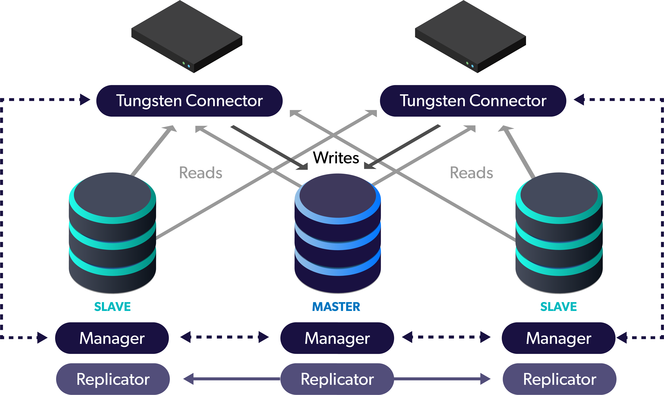
Tungsten Clustering
Continuous MySQL* Operations
Zero Downtime MySQL
Multimaster MySQL
Geo-Scale MySQL
Hybrid-Cloud and Multi-Cloud MySQL
Intelligent MySQL Proxy
Most Advanced MySQL Replication
Full MySQL Support, No Application Changes
16
* MySQL is understood in a broad context, including MySQL, MariaDB, Percona Server, RDS MySQL, RDS Aurora and Google Cloud SQL
Notes:
This covers:
Local rapid-failover, automated high availability
Fast local response times for read traffic (connector, proxy, read/write split)
No changes to app code

Slide 17
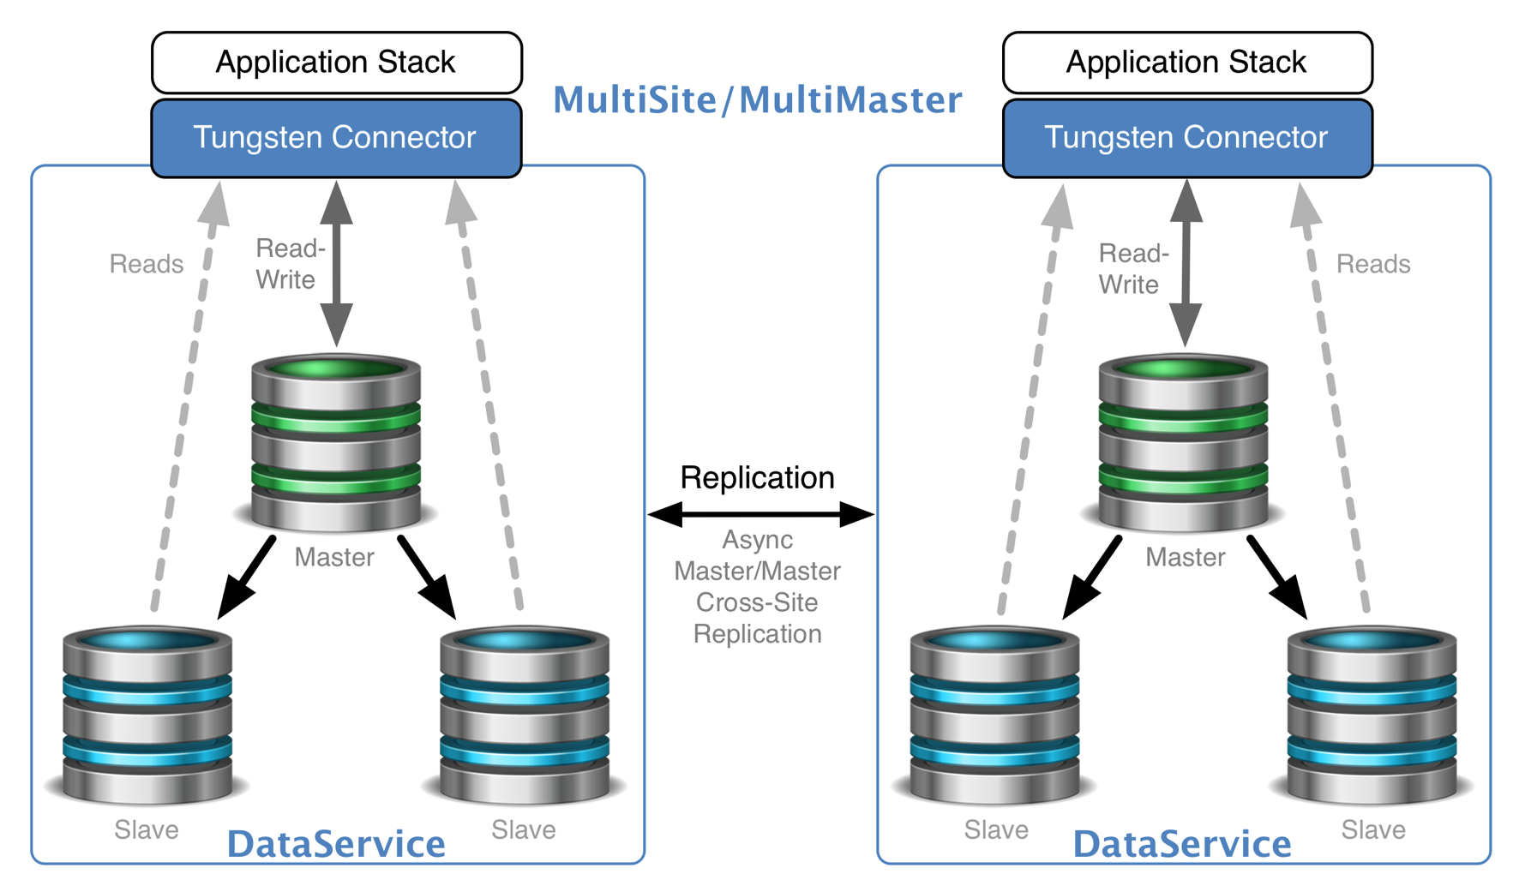
Tungsten MultiMaster Clustering
Scale to multiple Cloud Regions or datacenters
Platform-agnostic means you can span vendors and create hybrid topologies using any combination of cloud, VM and/or bare-metal servers
Active/Passive or Active/Active
Control all clusters from any node
Move the write primary from site to site with a single command when in Active/Passive mode
17
Active/Active Composite MultiMaster Cluster
Notes:
This covers:
* Multimaster deployments
Multi region
Multi / hybrid cloud

Slide 18
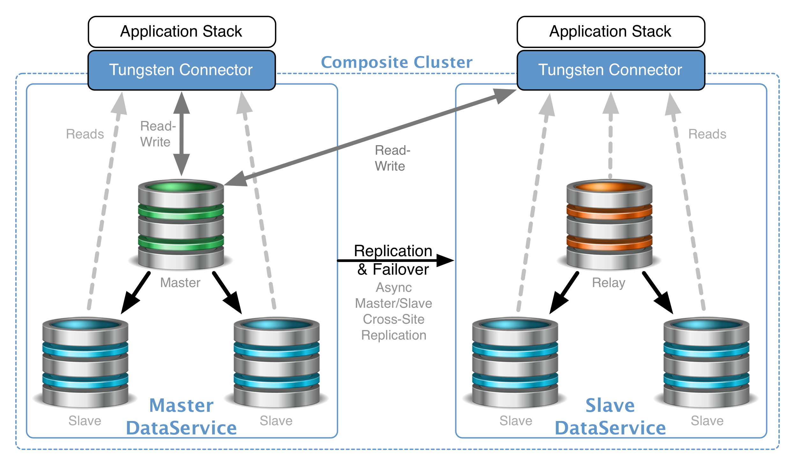
Tungsten Composite Clustering
Scale to multiple Cloud Regions or datacenters
Platform-agnostic means you can span vendors and create hybrid topologies using any combination of cloud, VM and/or bare-metal servers
Active/Passive
Control all clusters from any node
Move the write primary from site to site with a single command when in Active/Passive mode
18
Active/Passive Composite Cluster
Notes:
Yes, we can still do single global master as well

Slide 19
Zero Downtime Maintenance
Slave upgrade
Slave upgrade
Switch
Master upgrade
Shun slave
Upgrade MySQL
Return node to cluster
Discard and re-provision on failure
Repeat for remaining slave(s)
Switch master to promote an upgraded slave
Upgrade old master
Maintenance is now done!
Notes:
This covers:
No downtime maintenance
Online schema changes

Slide 20
Let’s Talk About Schema Changes

Slide 21
Fast DDL in Aurora
Certain DDL operations are magnitudes faster (sub second or seconds) compared to MySQL
Important because schema changes lock tables for writes, effectively creating down time/maintenance windows
After schema changes are applied to master, they must be performed on slaves (replicas) which can make them lag.
Fast DDL NOT supported for:
NOT NULL
Add Column BEFORE/AFTER
Columns with initial values!

Slide 22
Schema Changes, the Tungsten Way
Similar to rolling maintenance procedure that we just saw
We add a replication filter to temporarily ignore new columns and columns to be dropped.
Perform schema changes on slave
Repeat for all slaves
Promote a slave to master
Run schema changes on old master
Remove filter
Done

Slide 23
Schema Changes (example)
Alter table myschema.mytable
add column matt varchar(32) after somecolumn,
add column wins int default 1,
drop column oldcol;
[ { "schema": ”myschema", "table": ”mytable", "columns": [”matt",”wins",”oldcol"] } ]

Slide 24
Continuent Tungsten Key Benefits as compared to Aurora
Aurora | Continuent Tungsten
Not MySQL, but MySQL 5.6/5.7-compatible | Supports all MySQL versions (including Percona Server and MariaDB)
Read Replicas | Replicas available for auto read/write split, fast failover
Distributed back-end file system | Local filesystem, full access to local databases
Cross-Region Replication within AWS | Replicate to any cloud, on prem, or combination with multiple masters
Auto maintenance and interruptions | Zero downtime maintenance

Slide 25
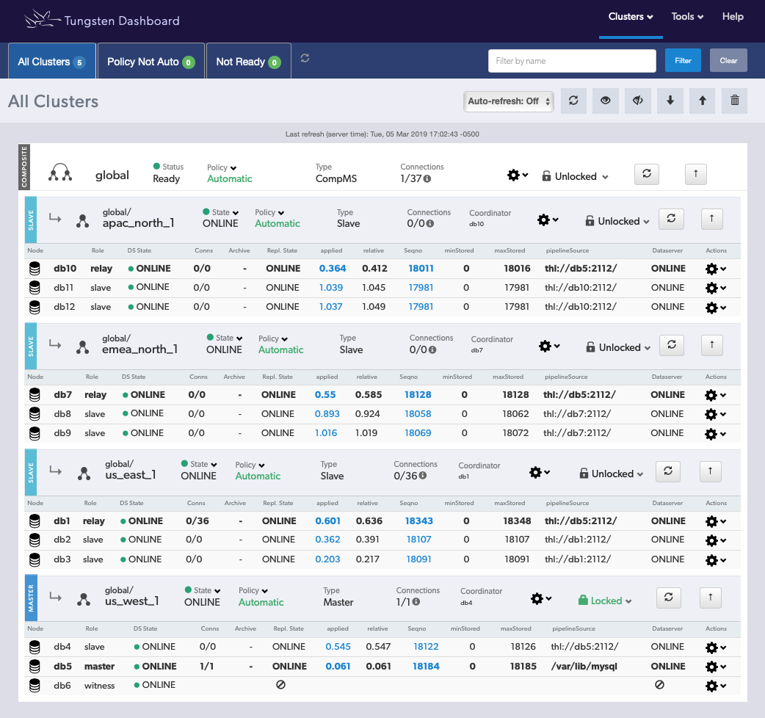
Tungsten Dashboard View
Notes:
This covers:
* Consolidated view

Slide 26
About Continuent

Slide 27
About Continuent
Continuent, the MySQL Availability Company, provides solutions for continuous operations enabling business-critical MySQL applications to run on a global scale with zero downtime.
Continuent provides geo-distributed MySQL high availability on-premises, in hybrid-cloud, and in multi-cloud environments.
Continuent customers are leading SaaS, e-commerce, financial services, gaming and telco companies who rely on MySQL and Continuent to cost-effectively safeguard billions of dollars annual revenue.
Continuent’s database experts offer the industry's best 24/7 MySQL support services to ensure continuous client operations.
Notes:
11:30

Slide 28
Proven Team
The core Continuent Team has been building data service solutions since 2004.
In 2014 VMware acquired ‘old’ Continuent, the best-of-breed DBaaS company, to offer their own DBaaS for vCloud Air.
‘New’, independent Continuent was spun off from VMware in 2016 after VMware changed its cloud strategy.
In 2019 Continuent is ready to launch an all-new Tungsten Cloud, extending and expanding the functionality of Continuent Clustering in to the Cloud

Slide 29
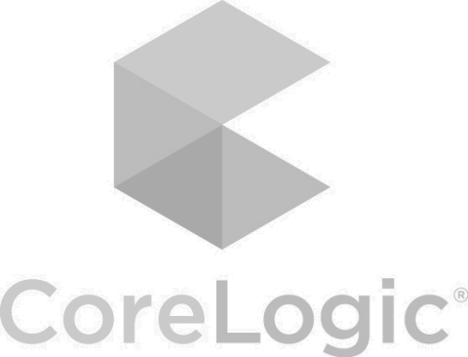
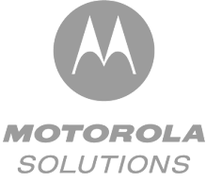
Proven Solutions
Our solutions handle billions of transactions per day and support businesses with billions of dollars in combined revenue:

Slide 30
Continuent Tungsten Solutions
Tungsten Clustering Tungsten Clustering allows enterprises running business-critical MySQL database applications to cost-effectively achieve continuous operations with commercial-grade high availability (HA), geo-graphically redundant disaster recovery (DR) and global scaling.
Tungsten Replicator Tungsten Replicator supports real-time data replication from MySQL into AWS RedShift, Cassandra, ClickHouse, Elasticsearch, HDFS, Kafka and Vertica to derive insight from analytics for better business decisions and increase revenue.
* MySQL understood in a broad context, including MySQL, MariaDB, Percona Server, RDS MySQL, RDS Aurora and Google Cloud SQL
Notes:
Note: Instead of one portal, we may have separate portals for MySQL (Tungsten MySQL Cloud) and MariaDB (Tungsten MariaDB Cloud).)

Slide 31
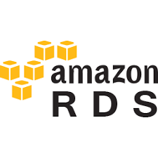
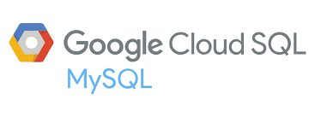
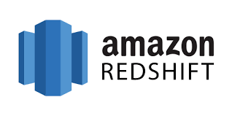
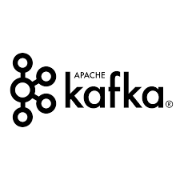
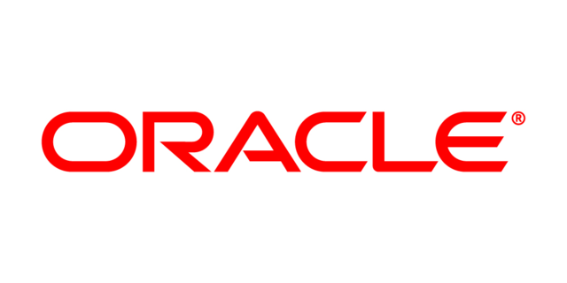
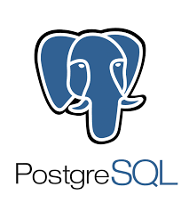
Tungsten Replicator
Tungsten Replicator, the core underlying technology for Continuent Tungsten, supports data replication from MySQL sources to AWS RedShift, Cassandra, ClickHouse, Elasticsearch, HDFS, Kafka and Vertica.
The same, proven replication mechanism supports data replication from clustered MySQL databases to high-performance NoSQL and data analytics engines
Derive insight from big data for better business decisions
Create new revenue opportunities with already existing data

Slide 32
Tungsten Key Benefits
Continuous MySQL Operations
MySQL High Availability and Disaster Recovery solution, which provides redundancy within and across data centers
Immediate failover for maximum availability and data protection of business-critical MySQL applications
Reduce MySQL recovery time from hours or days to mere seconds
Dashboard provides graphical view and management of all globally distributed MySQL clusters
Zero Downtime MySQL
Site-level and cross-site failover ensures application availability
Upgrade hardware, software and data without taking applications offline
MySQL compatibility means seamless migration of your data and applications
Notes:
Pick up pace here, encourage to read the handout

Slide 33
Tungsten Key Benefits
Multimaster MySQL
Multiple geographically-distributed write masters can provide higher availability due to lack of failover between sites
Lower-latency response times for reads for co-located application servers
Geo-Scale MySQL
Load-balance MySQL read operations across multiple slaves, locally and globally
Geo-distributed MySQL clusters bring data close to your application users for faster response times
Easily add more MySQL clusters as needed for unlimited scaling, both locally or across the globe
Hybrid-Cloud and Multi-Cloud MySQL
Deploy in the cloud, VM and bare metal environments
Mix-and-match on-premises, private and public clouds (incl. Amazon AWS, Google Cloud and Microsoft Azure)
Easy, seamless migration from cloud to cloud to avoid vendor lock-in in any specific cloud provider
Withstand node, data center, zone or region failures or outages

Slide 34
Tungsten Key Benefits
Intelligent MySQL Proxy
Provides intelligent traffic routing to a valid MySQL master, locally and globally
Scale read queries via query inspection and other methods
Application and active users do not disconnect during MySQL master failover events
Most Advanced MySQL Replication
Filter and transform your data in-flight
No more ETL, get real-time data feeds into your analytics
Replicate directly into popular analytic repositories: AWS RedShift, Cassandra, ClickHouse, Elasticsearch, HDFS, Kafka and Vertica
Unlimited real-time transactional data transfer to eliminate escalating replication cost of ETL-based alternatives

Slide 35
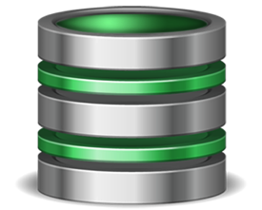
WHY: Significant Benefits
Geo-scale, Availability, Disaster Recovery
Low-latency, geo-distributed data access with a single consolidated providing fast response times for read traffic and local, rapid-failover automated high availability.
Simple administration, system visibility and stability also help create high return on investment.
VPC
us-west-1
VPC
us-east-1
VPC
apac-north-1
VPC
emea-north-1

Slide 36
Tungsten Key Benefits
Cost Savings
Use the free open-source MySQL for your business-critical needs
Optimize costs by selecting the most cost-effective cloud environment(s) at any given time
Eliminate downtime risks and associated cost, also during maintenance (zero downtime maintenance operations)
Reduce DBA time spent on admin and recovery operations, lowering your costs while increasing reliability.
Full MySQL Support, No Application Changes
Deploy and Configure MySQL clusters in minutes
Not ‘MySQL-compatible” solution. Use any of your off-the-shelf MySQL, MariaDB and Percona Server versions
Support for all modern MySQL (5.x through 8.x) and MariaDB (5.x and 10.x) versions and features
SSL support for all in-flight traffic
Native MySQL support means easy and complete migration of your data and applications

Slide 37
Tungsten Key Benefits
Last, but not least…
Industry-Best 24/7 MySQL Customer Service
Highly Qualified 24/7 support. All support team member have 15 or more years of MySQL DBA and Site Reliability Experience
24/7 support comes with 1-hour SLA, with response times for urgent requests averaging less than 5 minutes
MySQL uptime measured in months or years

Slide 38
Recap

Slide 39
With Continuent, you get…
Revenue protection
Revenue upside
Real-time data
Lower TCO
Stellar 24/7 customer support

Slide 40
Next Steps
Sign up for a private demo for your team, setup a POC, email us at sales@continuent.com
Learn more at your own pace
Training and webinar library at www.continuent.com/videos/
White papers at www.continuent.com/white-papers/
Read the documentation at http://docs.continuent.com/

Slide 41
For more info…
Eero Teerikorpi
Founder, CEO
eero.teerikorpi@continuent.com
+1 (408) 431-3305
Eric M. Stone
COO eric.stone@continuent.com
Jean-Jerome Schmidt
VP Marketing
jean-jerome.schmidt@continuent.com
Robert Noyes
VP Sales robert.noyes@continuent.com +1 (650) 575-0958
Matthew Lang
Director, Professional Services Americas
matthew.lang@continuent.com
Chris Parker
Director, Professional Services EMEA & APAC
chris.parker@continuent.com

